Slide 1
590 Lecture 7

Slide 2
What We’ve Covered
Week 1: Research Topic & Question
Week 2: Method & Recipe for the Literature Review
Week 3: Vibe Scholarship - Applying AI to Close & Distant Reading
Week 4: Reading Spivak with AI & Writing for Humanities and the Sciences
Week 5: Structuring the Literature Review
Week 6: Sociology of Knowledge / Reflexivity / Acknowledging AI

Slide 3
This Week - Final Week
Topical discussion: The Automatic Academy? The Future of Scholarship
Synthesizing the course into a draft review - Preparation for Final Assessment
Take summary paragraph from Week 6 and expand into 1,500 - 2,000 words
Re-cap on course purpose

Slide 4
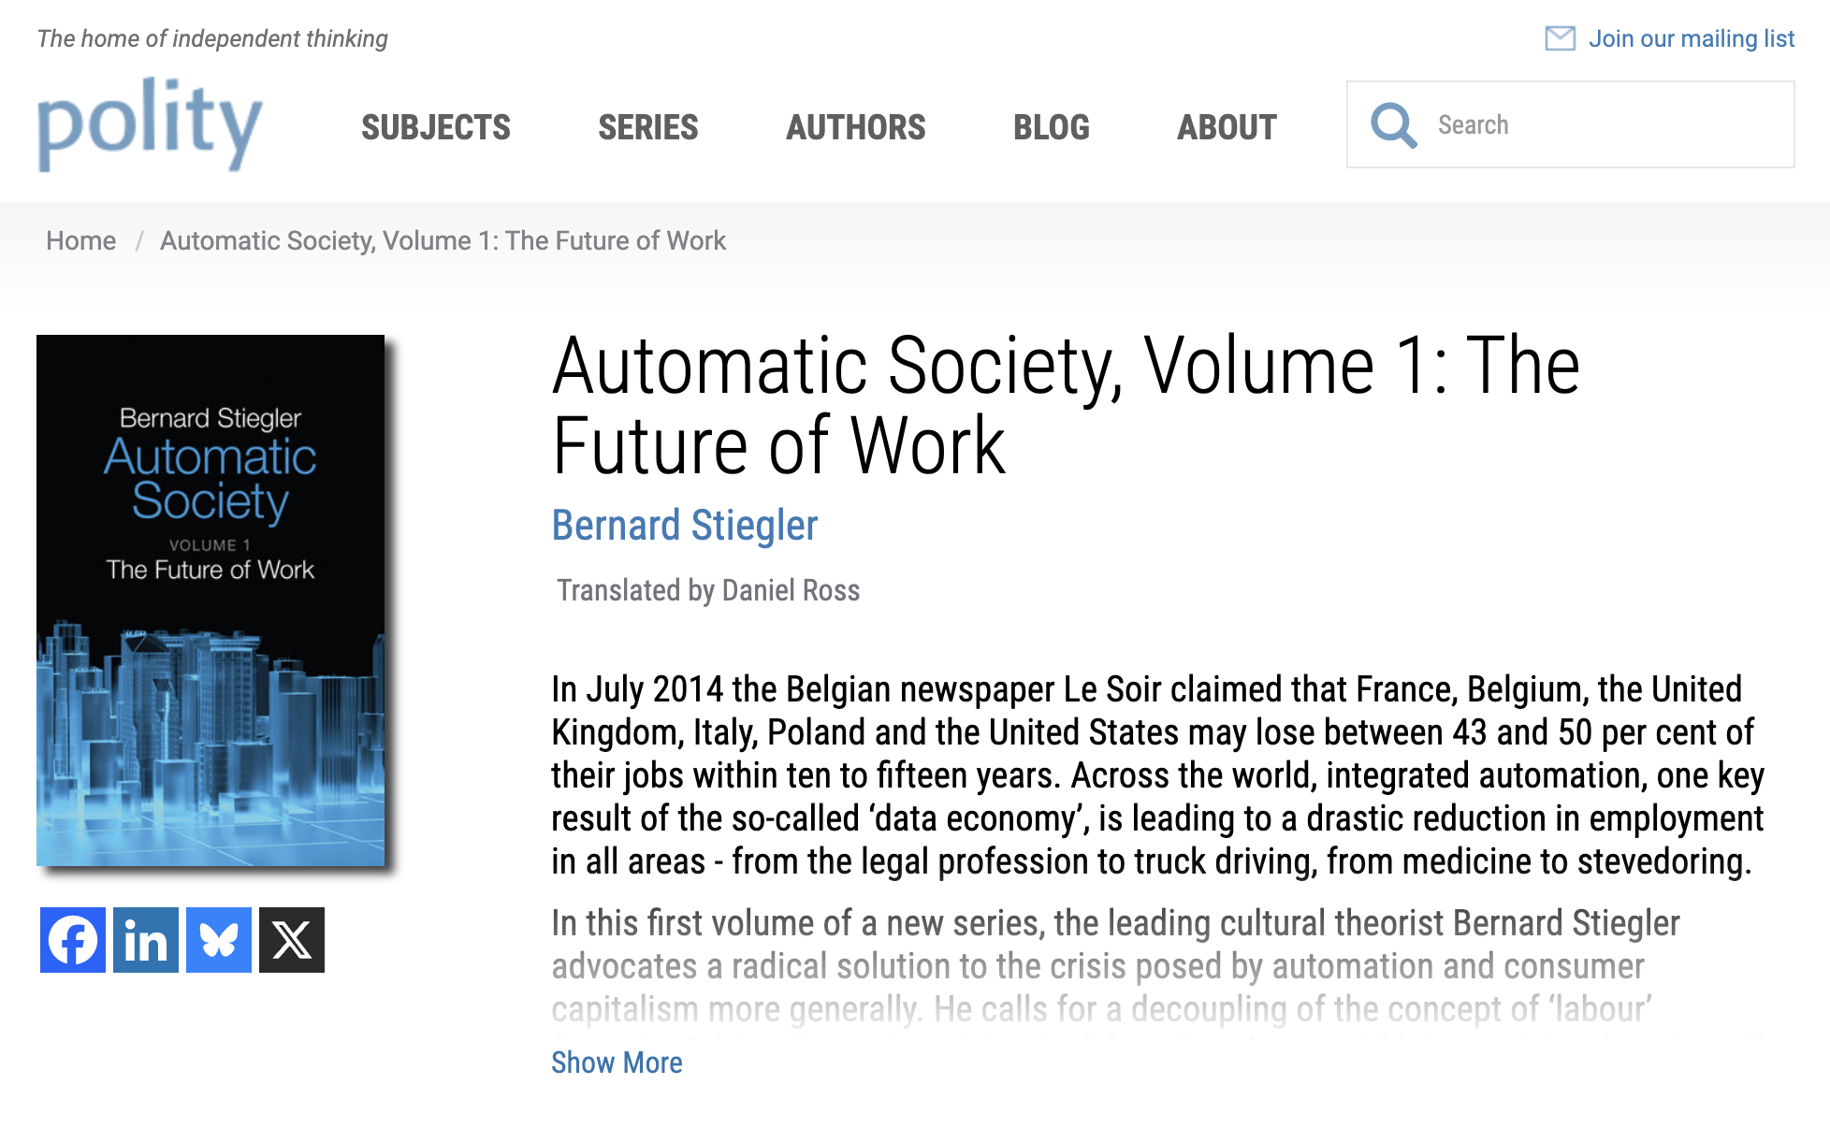
The Automatic Academy? The Future of Scholarship
Let’s test ChatGPT group chat…
Where is automation happening? Some examples….
Image

Slide 5
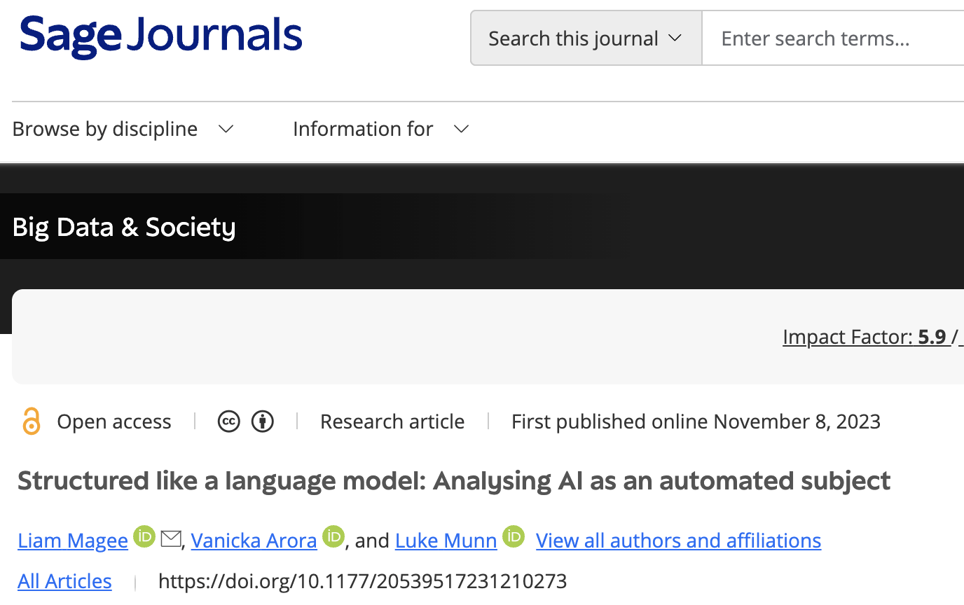
Anthropic Interviewer
Introducing Anthropic Interviewer Anthropic - Compare with Magee et al. 2023 - tables have turned (AI now interviewing the human)
Image

Slide 6
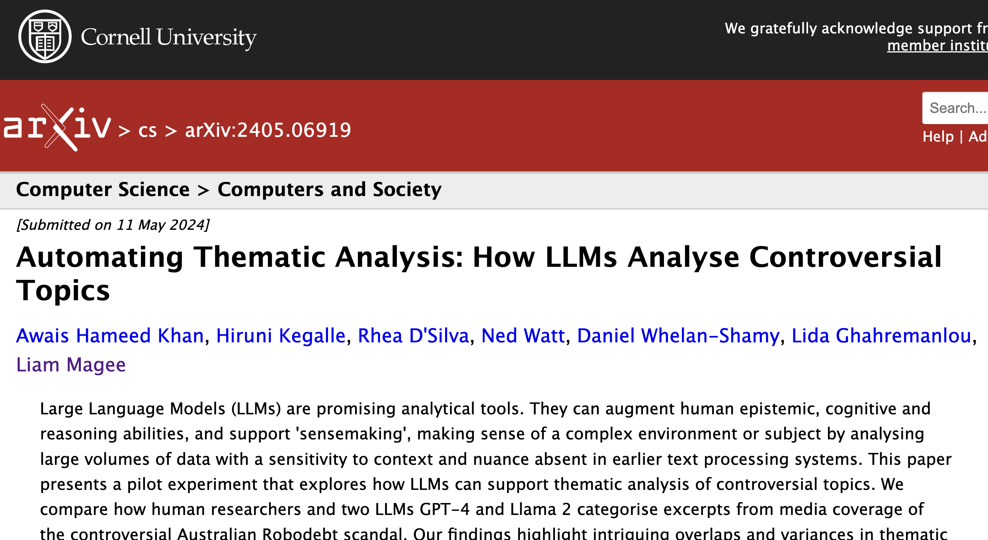
Thematic Analysis
Human vs LLM thematic analysis: - Algorithms are biased - but run against human bias - Coding fatigue - too many themes, sense of duplication, saturation - The machine doesn’t tire… related but different biases
Image

Slide 7
Literature Gap Analysis - Google Scholar Labs
Sign in - Google Accounts

Slide 8
Agent-based Models
“Computational sociology” - building models to simulate complex behavior
Sign in - Google Accounts
Claude claude.ai

Slide 9
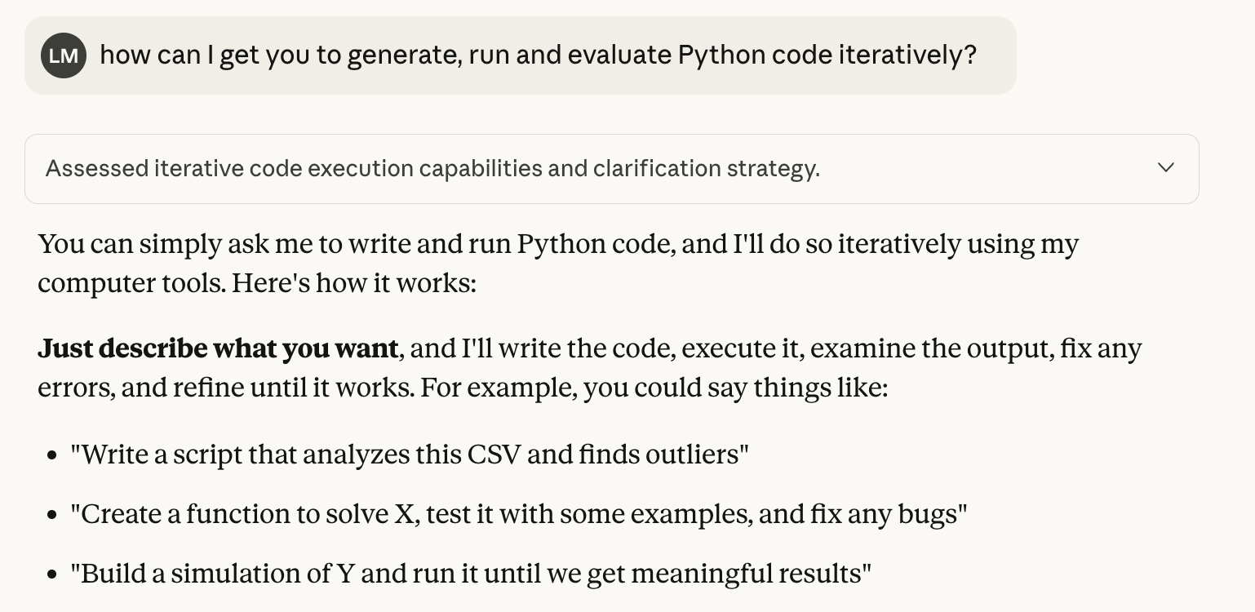
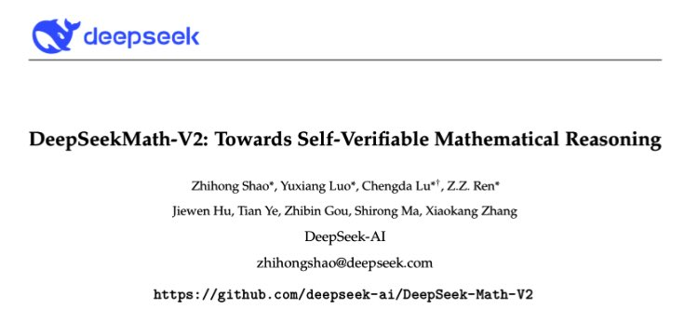
Mathematical / Scientific Research
Common approach now to problem-solving - so-called “neuro-symbolic” reasoning
LLM + tools - specifically Python
Solve some problem - watch AI generate, run & evaluate Python code
Image
Image

Slide 10
Social Science Survey Research
Design surveys
Generate code and sample data for survey analysis
Compare results to the literature

Slide 11
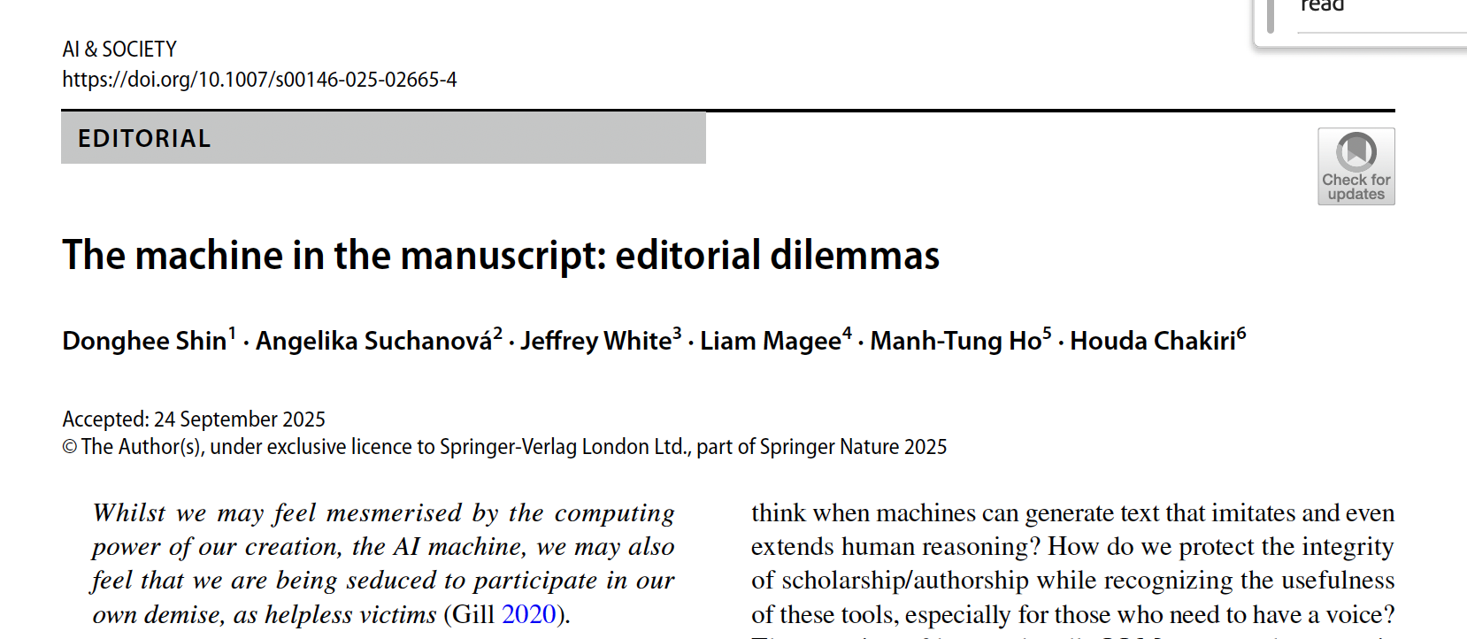
Crisis: LLM-generated knowledge
Huge amounts of AI-generated submissions to journals
“who, aside from the algorithms themselves, would want to read this LLM-generated content?”
Image

Slide 12
The Problem of Assessment
Why do we assess academic performance?
Does it make sense in the age of AI? What about Artificial Super Intelligence?
Think of the entire apparatus of the education “industry”: rubrics, criteria, marking, validation?
What are we even assessing? Individual aptitude, historical priviledge? Or the specific confluence of individual X with AI Y?

Slide 13
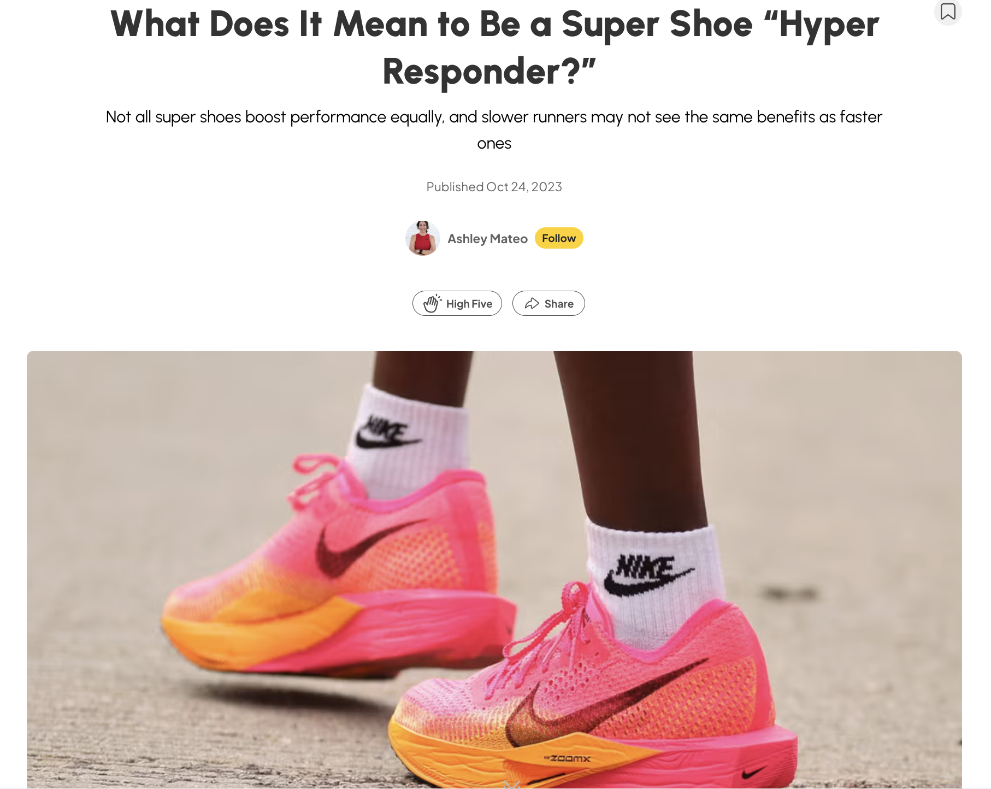
Analogy: “High Responders” to Technology
Example: Nike’s “supershoes” - some people respond better than others
Are some of us “high responders” to AI? Can
What is the role of assessment in preparing for a future of work? Is it just an arbitrary ranking?
Image

Slide 14
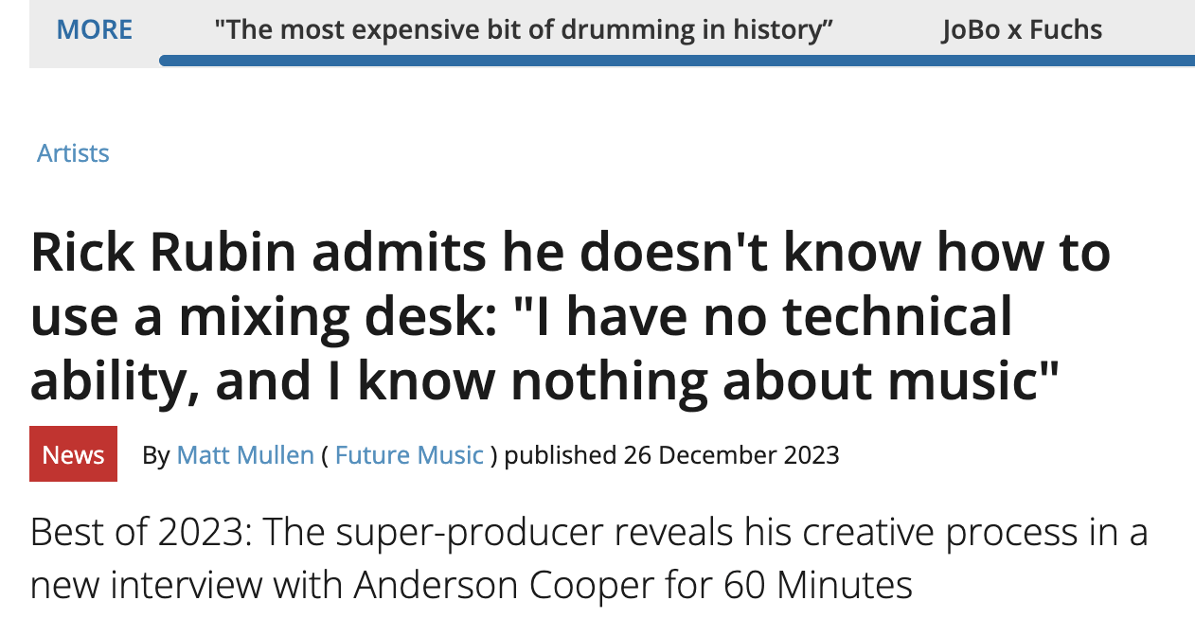
“Vibe” is perhaps a serious skill…
What does Rick Rubin (music producer) actually “know”?
In scholarship: developing a “feel” for questions worth asking - and how to answer them
Important? AI accelerates locating dead ends… This is not the gap you think it is.
Image

Slide 15
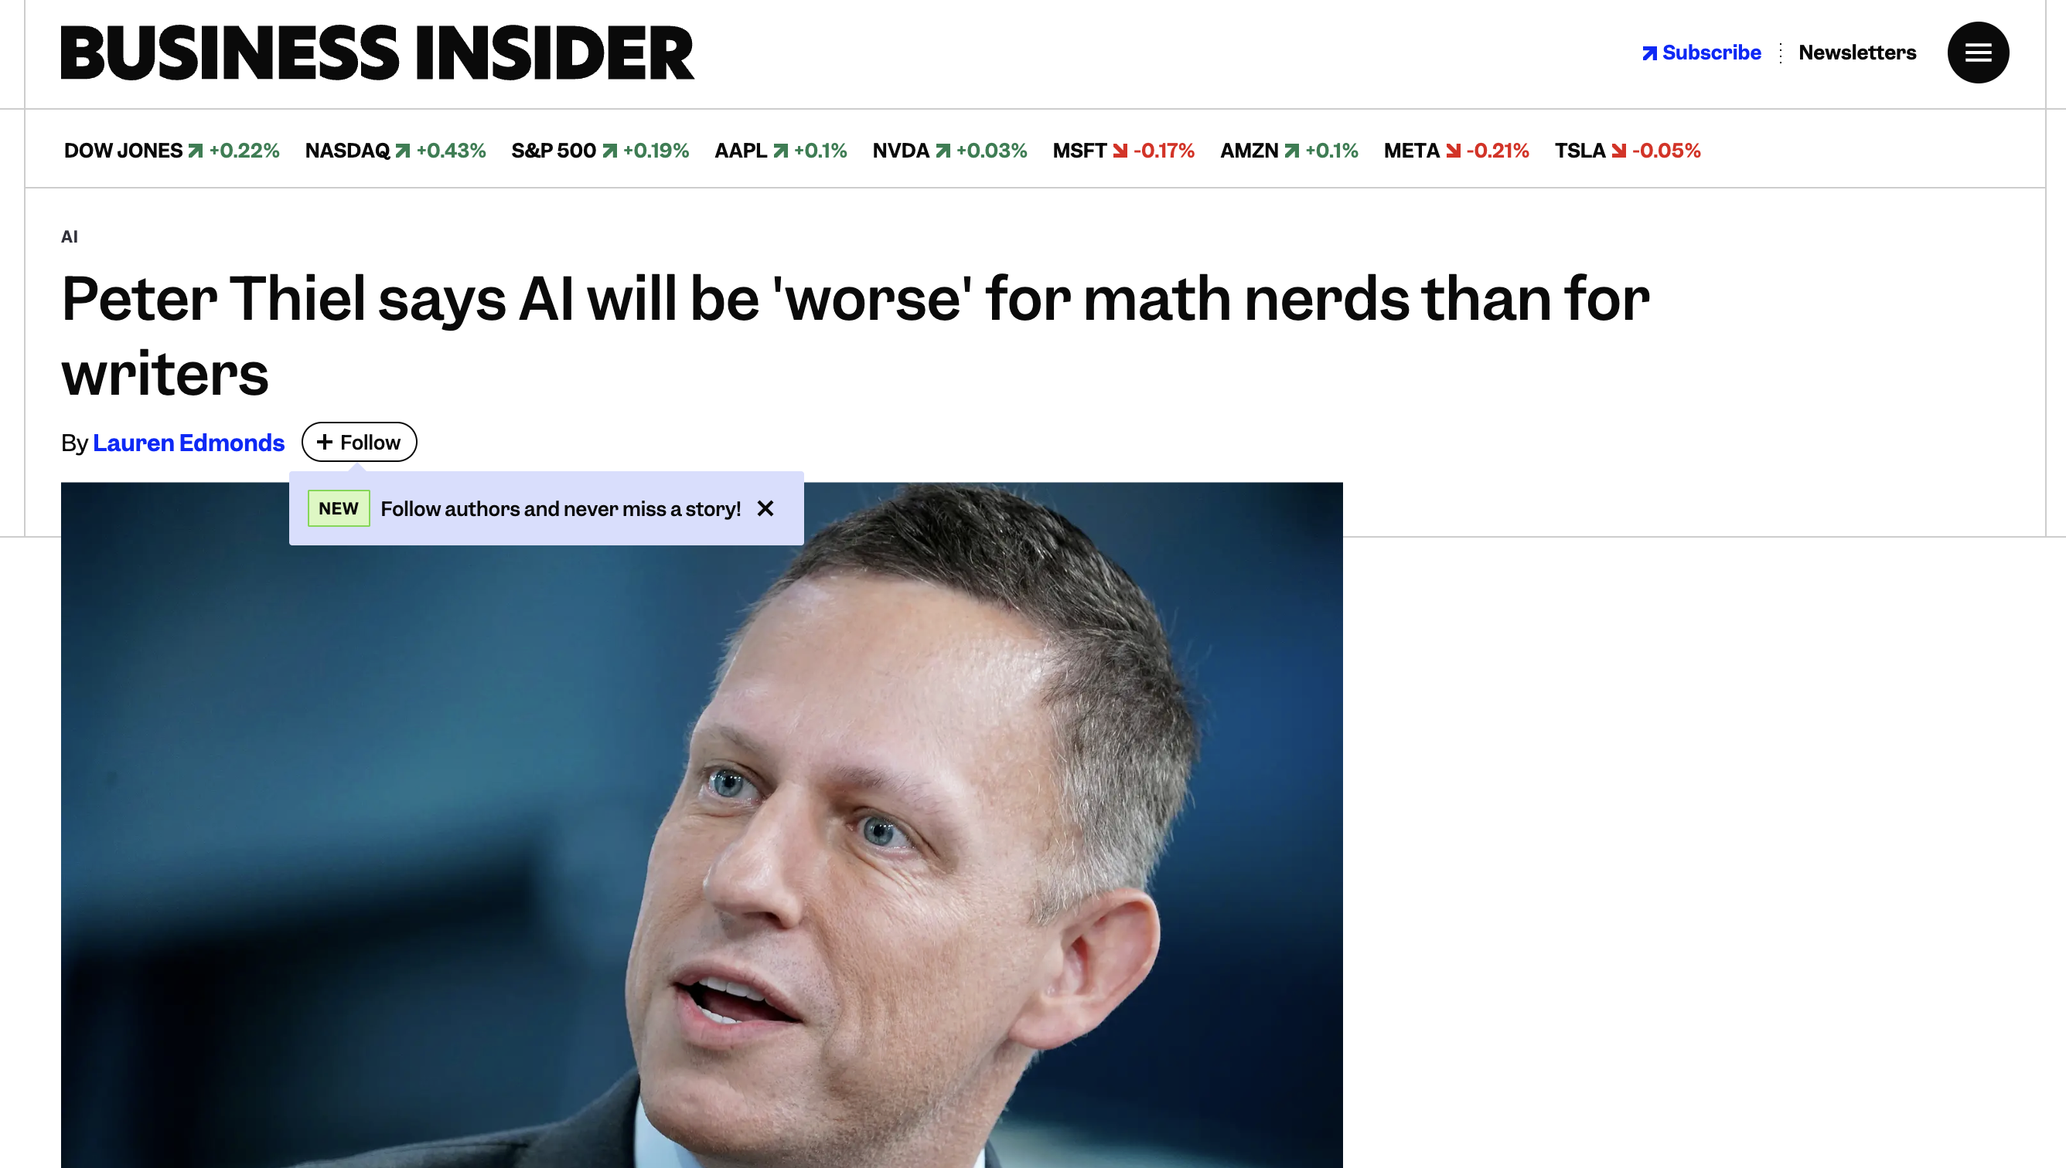
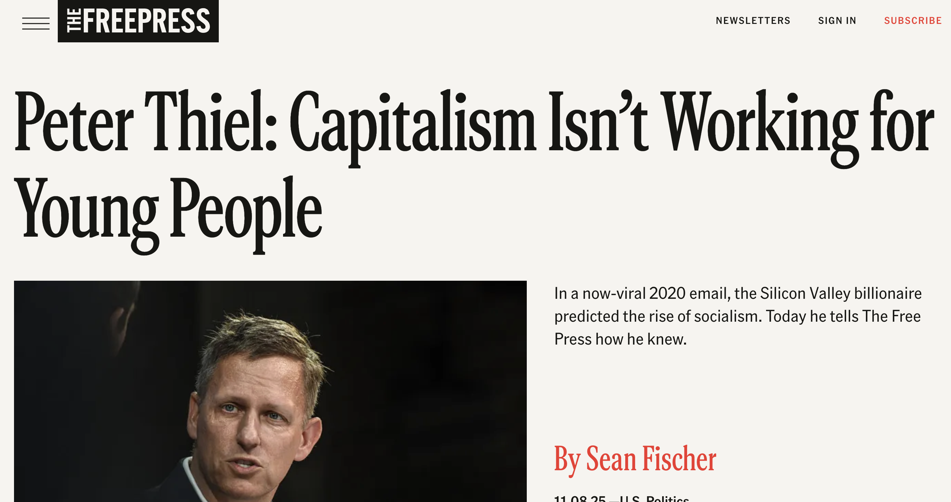
From the Heart of Silicon Valley…
Image
Image

Slide 16
Skills are always “Meta” Skills
My bias: develop the liberal arts - these are the “super shoes” / meta skills for an era of LLMs
AI literacy = general literacy? The more “expressive” you are, the more you can make a LLM “sing”.
Perhaps these skills are not really that assessable
What difference does it make? What does a world without differentiation (skills, work ethic, etc) mean?

Slide 17

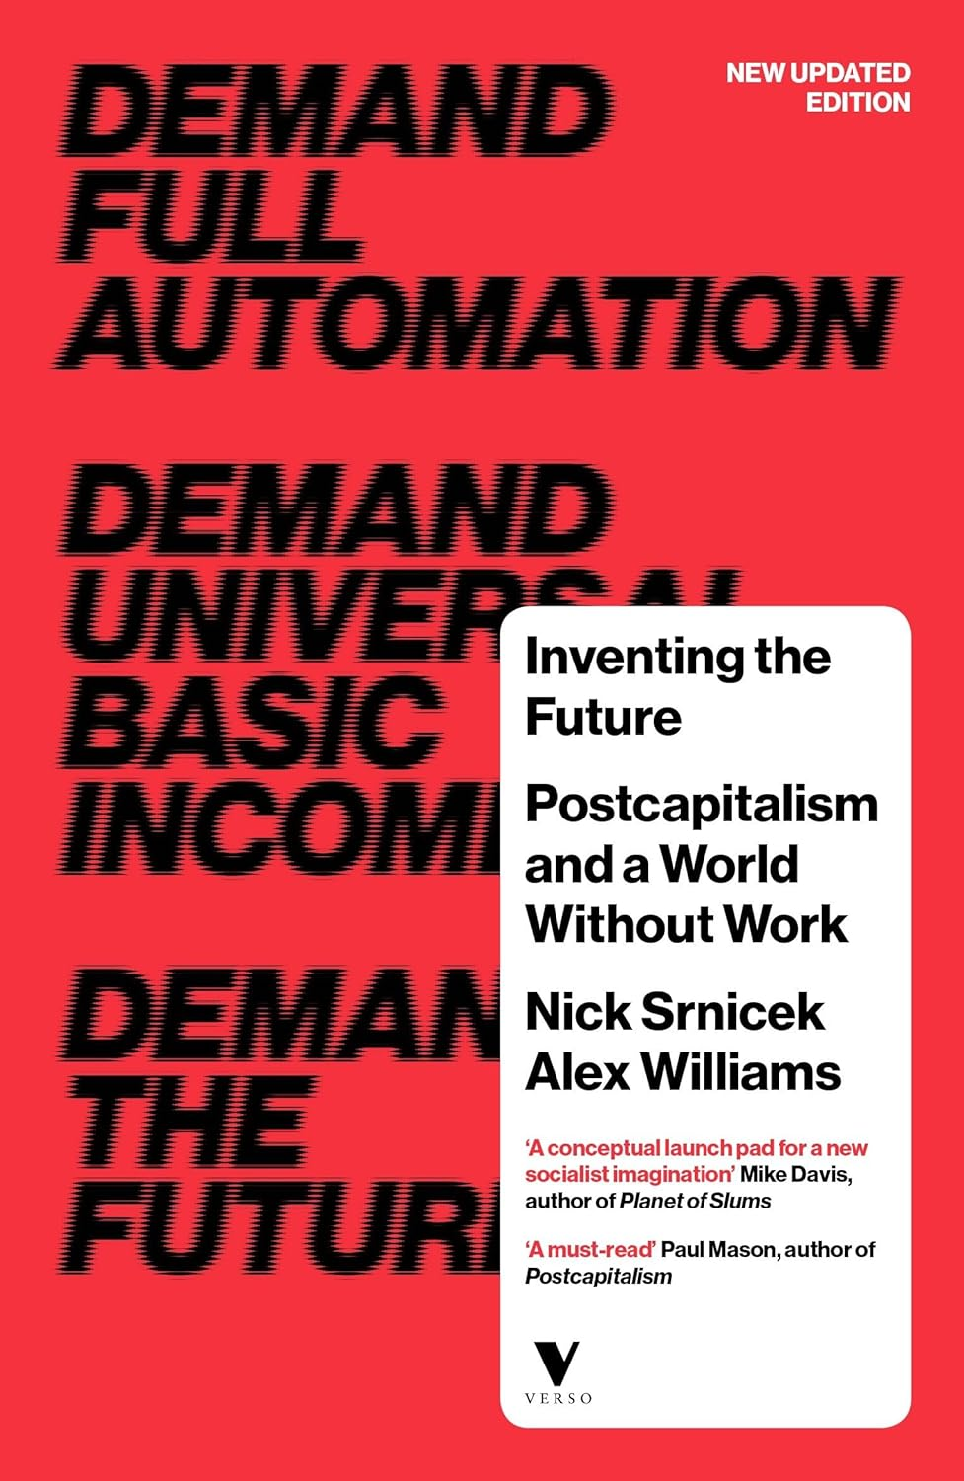
Implications? The Post-Assessment Age
Does everyone just get a free car now? The return of the “planned economy”
Image
Image

Slide 18
Stiegler’s Nightmare
The Automatic Society
Proletarianization:
From loss of ownership (Marx - means to production) to loss of knowledge (more literally “savoir-faire”: know-how)
Connected also with the rise of knowledge economy, immaterial labor: work is now cognitive, informatic - susceptible to automation by artificial cognition
Plato’s Pharmakon: writing is poison (destroys memory) but also cure (sustains memory)
Technology leads to collective loss of knowing-how - Can be “cured” by alternative organizations of technology and social conditions (but how? answers are non-specific, strangely reactionary)

Slide 19

Ruha Benjamin’s Race After Technology
“Abolitionist Tools”
Translation to scholarly contexts: thinking AI as a liberational technology - non-competitive knowledge without assessment, careerism, quantification, discrimination
Image

Slide 20
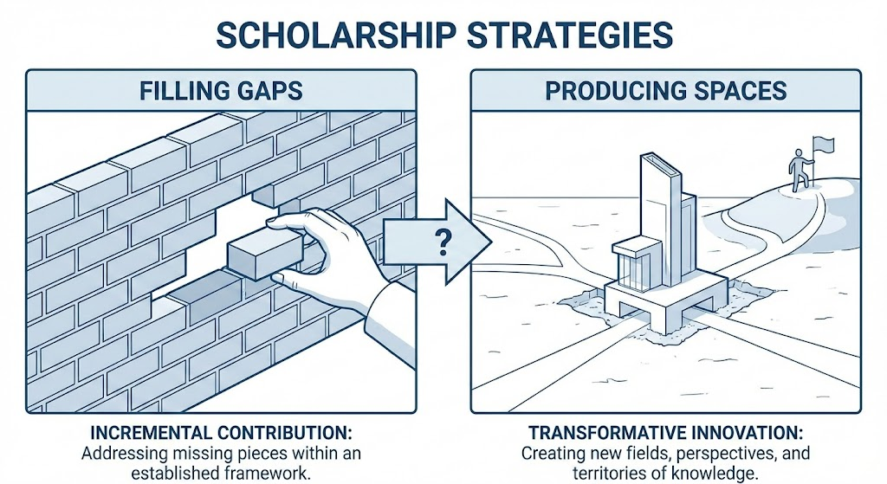
Filling gaps vs Producing spaces
Perhaps: to re-thinking knowledge beyond a logic of accumulation (the metaphor of filling “gaps” might be a trap for us here - as through knowledge is a container)
Instead focus on knowledge as creative, expansive - instead producing gaps, spaces - fractal metaphor
Image

Slide 21
What does this all mean?
AI is disruptive, threatening: to what we think of as the correct, established ways of doing things can be accelerated, automated.
De-stabilized (already low) confidence in academic institutions - anyone now can produce a report
Yet now indispensable to the work of scholarship
Requires new fundamental orientations toward the purposes and methods of scholarship, knowing…

Slide 22
Final assignment
My emphasis on this course is on the workshop nature of the material - aims to prepare for general / special field, other literature review work
Grading will be indicative of this
What is an “A”?
Roughly 1 - 1.5K words - use of concise language
Heavy use of signposting / metadiscourse
Demonstration of clear principle of organization (thematic / chronological / developmental etc)
Appropriate use of language for the apparent audience
Some sense of an independent and critical stance toward your material
Statement of gap filled (or space to be produced) by your research
And the persuasiveness of this statement, given the preceding evidence from the literature
Due acknowledgement of AI
I won’t know your field: I won’t be grading on whether you include everything

Slide 23
Activity: Dialectical Exchange
Background: What is the dialectic?
Socratic dialectic - find the truth via relentless questioning (think: TV lawyers)
Truth is “whittled away” from the error that surrounds it
Question (Socrates) and answer (respondent) progressively move towards the truth (truth is journey / process)
Hegelian dialectic: same idea, but more formal:
Thesis: the current status quo
Antithesis: an opposing view
Synthesis: the reconciliation of thesis and antithesis

Slide 24
Can AI be a dialectical partner / guide?
System Prompts - Claude Docs
ERAM 590 - Google Docs
Following Claude’s example we are going to develop a fancy multipart prompt: - Assignment (from the syllabus) - Criteria - Assessment - Review Synopsis - Review Structural Principle - Review Audience - Dialectic Prompt
Why so fancy?

Slide 25
Variants on the Dialectic Prompt
I need to write this literature review. Don’t write it for me. Instead, be my dialectical guide. Using criteria, structural principle and audience, help me develop the synopsis into an ‘A’ grade paper!
Be my Socratic dialogue partner.
I want to illustrate for a class the process of the dialectic, with AI as partner / guide. Below is a synposis of a literature review. Let’s call this the “thesis”. Can you examine this thesis, engaging in a dialectical process to pose an antithesis - then help arrive at a synthesis?

Slide 26
Final Literature Review (40%) Throughout the course you will develop a literature review around a research topic and question of your choice. This may relate to a future dissertation topic or question, or some other research question. In total, the Literature Review should be 6-8 pages in length. • Develop novel, significant and feasible research question • Compile relevant map of the field relating to the research question • Choose and apply appropriate citation practices (science / humanities / mix) for question & field • Use framing / signposting / metadiscursive language • Show reflexivity as a scholar • Acknowledge and demonstrate appropriate use of AI • Use all of the above to highlight a plausible gap in the literature - What is an “A”? - Roughly 1.5 - 2.0K words - use of concise language - Heavy use of signposting / metadiscourse - Demonstration of clear principle of organization (thematic / chronological / developmental etc) - Appropriate use of language for the apparent audience - Some sense of an independent and critical stance toward your material - Statement of gap filled (or space to be produced) by your research - And the persuasiveness of this statement, given the preceding evidence from the literature - Due acknowledgement of AI In this review, I begin by outlining current research on the technical performance and global expansion of LEO satellite networks. I then examine scholarship addressing digital inclusion challenges in underserved regions, highlighting persistent infrastructural and socioeconomic barriers. I further explore studies on technology-enabled learning initiatives, emphasizing what is known—and what remains speculative—about satellite-supported education models. Finally, I demonstrate that while these bodies of research each contribute important insights, none sufficiently integrate technical, social, and pedagogical perspectives to explain how LEO satellites can equitably support learners in remote communities. As a result, this review establishes the need for a unified, implementation-focused framework that bridges technological capability with educational equity. The literature review will be organized according to theme. Tech-savvy but critical scholars. Probably trained in STS (Latour, Law, Benjamin etc). I need to write this literature review. Don’t write it for me. Instead, be my dialectical guide. Using criteria, structural principle and audience, help me develop the synopsis into an ‘A’ grade paper! </dialectic_guide

Slide 27
Re-cap on course purpose
Dual: - ERAM - focus on mechanics, technical detail of the literature review - But also examine how AI is being worked into practices of scholarship - and to be attentive and crtical towards that - Future is complex, challenging - “cyber-social” – with mixed effects and opportunities - Need for critical AI literacies - stay vigilant!

